Slide 1



HackOrbit 2025
Team Name:
TechRx

Slide 2
Problem Statement:
SeismoCast: Machine Learning-Based Earthquake Magnitude Estimation from Spatial-Temporal Data
Welcome to SeismoCast, a revolutionary approach to disaster management through advanced earthquake magnitude estimation. Our project leverages the power of machine learning and spatial-temporal data to provide rapid, accurate earthquake predictions, enhancing urban planning and awareness.

Slide 3
SeismoCast: Our Solution
SeismoCast proposes a robust machine learning solution to address the critical need for rapid and accurate earthquake magnitude estimation. Our model is designed to process complex spatial-temporal data, providing near real-time predictions that can revolutionize disaster management.
Core Solution
Tech Stack
Machine learning model trained on extensive historical seismic and geospatial datasets.
Programming Language: Python
ML Frameworks: Scikit-learn, XG Boost(for eXtream gradient boosting)
Ingests spatial-temporal features, hypocentral depth, and epicentral coordinates.
Data Handling & Preprocessing :Pandas – For loading CSVs, handling data frames, NumPy – Used for vectorized distance calculations and numeric operations.
Delivers earthquake magnitude predictions, based on historical seismic patterns.
Frontend/Web interface :Streamlit – Core Python framework for building the interactive app UI.

Slide 4
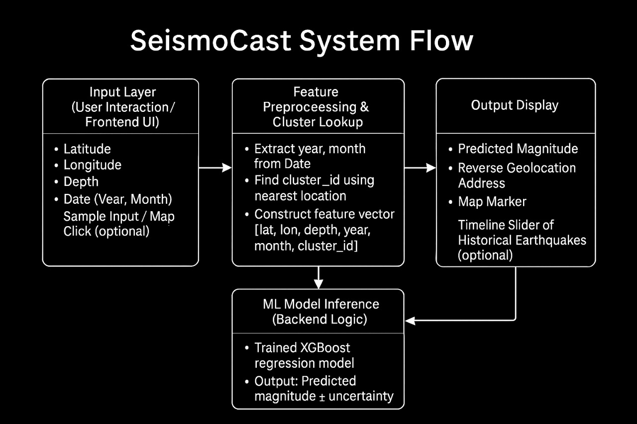

Slide 5
Operational Deep Dive: How SeismoCast Works
SeismoCast transforms raw seismic data into actionable insights through a meticulously designed workflow. Each component plays a vital role in ensuring rapid and accurate earthquake magnitude estimation.
Data Ingestion
The user provides spatial (latitude, longitude), temporal (date), and geological (depth) data through an intuitive Streamlit interface..
Feature Processing
From the provided spatial-temporal inputs, relevant features such as year, month, and pre-computed cluster ID are extracted or retrieved. These features help contextualize the input within known seismic zones.
Model Training & Prediction
Our ML model is pre-trained on extensive historical earthquake datasets. Upon receiving new seismic data, it performs time inference to predict the earthquake magnitude.
Visualization & Output rendering
The predicted earthquake magnitude will be displayed along with the reverse-geocoded location on an interactive map.Additional features like a timeline-based seismic activity viewer and clickable map inputs are planned to enhance user interaction and spatial insights.

Slide 6




SeismoCast: Innovative Features & Unparalleled Novelty
SeismoCast introduces several groundbreaking features that set it apart from existing solutions. Our focus on leveraging advanced deep learning and ensuring low-latency alerts positions us at the forefront of seismic prediction technology.
Simulation-Focused Design
Efficient Prediction Engine
Seismic Timeline Viewer
Rather than unreliable forecasting, the system simulates earthquake magnitudes under various hypothetical conditions — aiding in planning, research, and awareness.
The system uses a high-performance, non-neural model (XGBoost) that delivers fast, accurate predictions without heavy computational requirements — ideal for simulations and rapid deployment.
A timeline slider enables users to explore top earthquakes from past years, helping visualize historic patterns geographically..
Scalable Deployment
Designed for scalability, enabling seamless deployment across various regions via cloud or edge computing infrastructure.

Slide 7
Navigating Challenges: Drawbacks & Showstoppers
While SeismoCast offers significant advancements, we acknowledge the inherent complexities and potential limitations in earthquake prediction. Addressing these challenges is crucial for successful implementation and public trust.
Key Considerations
Data Quality Dependency: The accuracy of predictions relies heavily on the quality and consistency of real-time seismic data feeds.
Seismic Anomaly Sensitivity: Unforeseen seismic anomalies or unique geological events could potentially affect prediction accuracy and model stability.
Integration Hurdles: Successful deployment requires seamless integration with existing national geological data centers and their diverse systems.
Continuous Model Retraining: The machine learning model will require periodic retraining and fine-tuning as new earthquake data becomes available to maintain optimal performance.

Slide 8

SeismoCast Team
Our team comprises dedicated undergraduate and passionate about leveraging AI for societal impact. We bring together diverse skills in machine learning, data science, and software development to make SeismoCast a reality.
Pulastya Bhagwat (+91 9892350078)
Vaidant Chouksey (+91 7225054021)
Prerna Pandey (+91 6260842973)
Priyal Saxena (+91 9893947425)

Slide 9
Thank you

